Slide 1


principles of effective group work
For: Old Palace of John Whitgift School
Contact details:
www.suecowley.co.uk
sue@suecowley.co.uk
@Sue_Cowley

Slide 2
Key principles
Behaviour is a learning process
Be clear about why you are using group work and what you want learners to get from it – an explicit goal
Pre-empt issues and be proactive, rather than reactive
Give focus and energy to those who are ‘doing the right thing’ – aim to build relationships
Consider behaviour as a form of communication that can express a need – what is being communicated?

Slide 3
Key principles
Consider: what skills are missing which support effective group work?
Self-regulation, turn taking, empathy, language, processing, challenge, focus, time management …
Be proactive – find ways to build these skills
Consider the impact on behaviours of processing, understanding, motivation and engagement

Slide 4
Why Group Work?
Task/Goal/Outcome
Why this task/part of the curriculum?
What is the end goal of this activity?
What skills/knowledge will learners build?
What is the best option for grouping learners?

Slide 5

Why is self-regulation so important for learning and behaviour?
“consistently linked with successful learning”
“lasting positive impact on later learning”
(Education Endowment Foundation)
The Marshmallow Experiment

Slide 6
A brief guide to Self-Regulation
Executive function: working memory, mental flexibility, self-control
Be aware of, understand and manage own behaviours
Impulse control and deferred gratification

Slide 7
A brief guide to Self-Regulation
Maintain focus, direct attention, manage distractions
Awareness of strong feelings, self-calming strategies
Empathy - seeing other perspectives

Slide 8
A brief guide to Self-Regulation
Setting and achieving goals
Coping well with challenge and failure
‘Can do’ attitude – linked to sense of self

Slide 9
What Factors Support the Development of Self-Regulation?
Attachment to a trusted adult
Reliable availability of resources
Agency – control over self/world
High levels of intellectual and physical challenge

Slide 10
What Factors Support the Development of Self-Regulation?
Unconditional positive regard
Structured environment; managed risk
Serve and Return conversations
Links to language development – thinking through

Slide 11
Trusted Adults:
Establishing your Expectations

Slide 12
Confident communication
I know what behaviours we want/need
I look confident about getting the behaviours
I narrate the ‘why’ of the behaviours

Slide 13
a Focus on the positive
I highlight what’s going right
“This is how we do it here.”
I use statements not rhetorical questions

Slide 14
building the ethos
I reinforce and revisit the expectations
I model the expectations
I give my energy to those ‘doing the right thing’

Slide 15
Rights and Responsibilities

Slide 16
Rights and responsibilities
Structure conversations about R&R
Frame tasks to encourage collaboration
Find ways to add agency and accountability

Slide 17
Framing for rights
Frame for turn taking using ‘markers’
Clear boundaries around reactions to ideas
Teacher rights as well as student rights

Slide 18
Framing for responsibilities
Time target – pause and feedback
‘Markers’ of involvement: coloured pens
Specific roles linked to success criteria

Slide 19
Using Roles and Regulation to Support Collaborative Working

Slide 20
Some Options for roles
Simple Roles
Talk Partners/Think-Pair-Share
Triads: Speaker, Questioner, Scribe/Coach, Player, Umpire
Complex Roles
Jigsaw (Home/Expert) Groups
Silent Debate
2 – 4 – 8

Slide 21
Techniques for collaboration
Yes, but
Yes and
No

Slide 22
Building self-Regulation
Name the emotions – be explicit
Model the self-calming process
Promote empathy/other perspectives

Slide 23
Building self-Regulation
Praise agency rather than attainment
Give learners agency to repair mistakes
Narrate the thinking processes

Slide 24
Building self-Regulation
Trust (especially the hardest to trust learners)
Genuine opportunities to take risks/fail
‘Caring for’ activities

Slide 25
Building impulse control
Look for chances for learners to wait
Clarity of timings and targets
Always consider: who is doing the work?

Slide 26
Communication: Oracy, Questioning and Choices

Slide 27
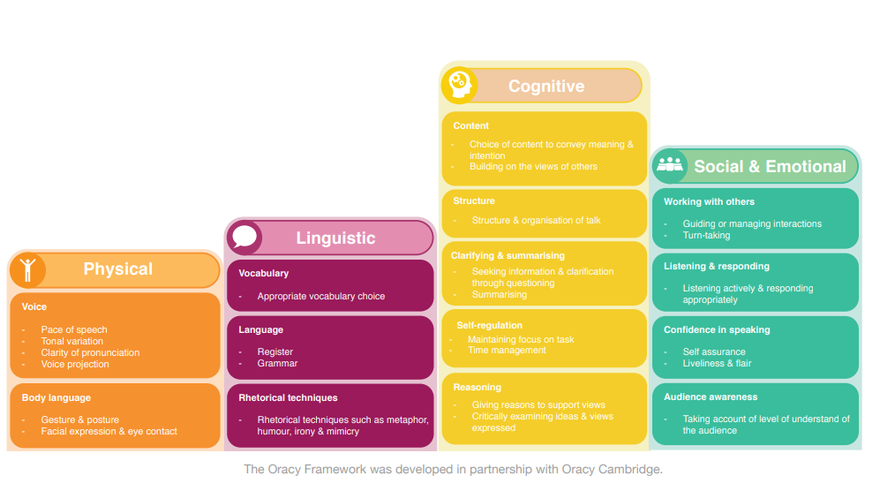
Voice 21: Strands of Oracy

Slide 28
Teacher communication
Self
Model self control
Know how to keep yourself calm
Voice/Body
Control tone, pace, pitch, volume
Use space, levels and movement
Activities
Think about room layout and behaviour
Clarity of goals to help create focus

Slide 29
Thinking Together Through Talk:
Talk Tactics
Instigate … I would like to start by saying …
Probe … What evidence do you have to support …?
Challenge … I disagree because …
Clarify … So, are you saying that …?
Summarise … The main points raised today are …

Slide 30
Thinking Together Through Talk:
Socratic Questioning
Respond to all questions with a further question
Understand the foundations of what is said
Treat assertions as connected to thoughts
Treat all thoughts as in need of development
Recognise that all questions presuppose prior questions

Slide 31
Socratic Questioning:
Question Types
Clarification – why do you say that/what exactly are you saying?
Challenging assumptions – why do you assume that/what could we assume instead?
Evidence and reasoning – what example backs this up/what are your reasons for thinking this?

Slide 32
Socratic Questioning:
Question Types
Alternative viewpoints – what might someone else think about this?
Implications and consequences – what are you implying by this/what might happen as a result?
Challenging the question – what does this question mean/what is the point of asking this?

Slide 33
The language of Choice
Encourage the learners to see their behaviour as their choice
Use the ‘language of choice’ when dealing with issues
Pre-empt issues to encourage good choices by thinking ahead

Slide 34
Pre-Empting group work issues
Refusing to participate with the group
Talking over others – ‘taking over’
Quarrels and lack of cooperation

Slide 35
Use of Motivators and Consequences

Slide 36
Consequences and motivators

Slide 37

Thinking about the NIKE learners
“Just Do It”

Slide 38
Why do some learners ‘just do it’?
Support from home, well parented
Naturally curious and interested in learning
Respect for (fear of) authority
Keen to please the teacher/adults
See the value of learning
Aiming for a long term goal, e.g. career
Enjoy working hard and being successful
See education as an escape route
Sibling rivalry – ‘keeping up with’ siblings
Love the particular subject
Inspired by a specific teacher or adult
Take pride in working neatly or well
Keen to earn rewards
Like to fit in and stay below the radar
Competitive – want to be the ‘best’

Slide 39
Why do some learners ‘just do it’?
How can we replicate those factors?
Support from home, well parented | Partnerships with parents, support for parents, nurture groups, breakfast clubs
Naturally curious and interested in learning | Show that learning is fun and engaging
Respect for (fear of) authority | Clear boundaries, visible, role models
Keen to please the teacher/adults | Discover what the individual learner enjoys
See the value of learning | Show why something is being learned
Aiming for a long term goal, e.g. career | Bring in ex-learners to talk about careers
Enjoy working hard and being successful | Set tough but achievable targets
See education as an escape route | Make school an ‘oasis’
Rivalry – ‘keeping up with’ peers/siblings | An element of competition (against self?)
Love the particular subject | Inspire them to love it: rediscover curiosity
Inspired by a specific teacher or adult | Analyse ‘inspirational’. Find a way to ‘click’
Take pride in working neatly or well | Displays, highlight examples, use ICT
Keen to earn rewards | Use rewards that they really want
Like to fit in and stay below the radar | Calm working atmosphere
Competitive – want to be the ‘best’ | Group competitions, compete against self

Slide 40

The Best Motivators …
Unexpected, unusual, creative, ironic
Reflect staff/learner relationships
Funny
A surprise!
Earned through co-operation
About the giving of time, attention, kindness
About social skills, as well as academic
Seen and noted by other adults/learners
Come from the learning - intrinsic over extrinsic
Not always given publicly

Slide 41
Any Questions?

