Slide 1
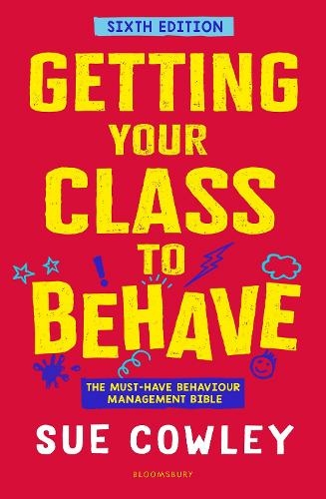
Book Launch Event: Ten Top Tips for Getting your Class to Behave
www.suecowley.co.uk sue@suecowley.co.uk @Sue_Cowley

Slide 2
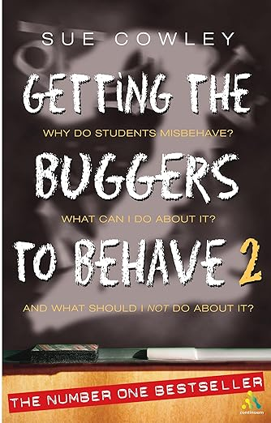
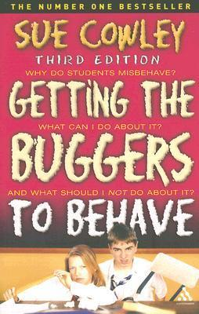
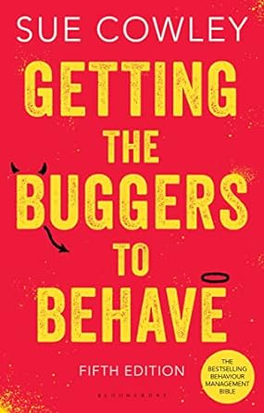
Before we begin … A ‘Brief History’ of my Behaviour Book

Slide 3
Tip No.10
Expectations are everything

Slide 4
Tip No.10
Use clear language – make sure that learners understand concepts
Ensure that you follow through, or it doesn’t mean anything
Model what you said you wanted

Slide 5
Tip No.9
Avoid the instinctive reaction

Slide 6
Tip No.9
It’s natural to get wound up by poor behaviour
Be aware of what your instinctive reaction will be
Aim to do the opposite

Slide 7
Tip No.8
Focus on the positive

Slide 8
Tip No.8
Give your energy to the learners who are ‘doing the right thing’
Shine a light on good behaviour
Aim for five positives before one negative

Slide 9
Tip No.7
Use ‘flexible consistency’

Slide 10
Tip No.7
It’s the standard that needs to be consistent, not the approach
Support and scaffold behaviour just like you do any learning
Flexible responses enable inclusion

Slide 11
Tip No.6
Non verbal communication sends a powerful message

Slide 12
Tip No.6
Prowl the teaching space like a cat, marking its territory
‘Touch all four walls’ during a lesson
Learners should never know quite when you might pop up

Slide 13
Tip No.5
Use more vocal tone than feels natural

Slide 14
Tip No.5
Tone of voice triggers the part of the brain that deals with emotions
Tone helps understanding, especially for learners with SEND/EAL
Tone encourages facial expressions

Slide 15
Tip No.4
All behaviour communicates something

Slide 16
Tip No.4
This is just how behaviour works
Read what is communicated and, if appropriate, respond to it
This doesn’t mean you have to pay attention to everything!

Slide 17
Tip No.3
Use statements not rhetorical questions

Slide 18
Tip No.3
If you ask rhetorical questions, you may get more than you bargained for!
Some learners will take you literally
Use positive statements of what you need instead

Slide 19
Tip No.2
Pre-empt the problem

Slide 20
Tip No.2
Be proactive rather than reactive
Consider what the problem is and how you can get in front of it
Aim to find creative solutions

Slide 21
Tip No.1
Sometimes, the best ‘answer’ is to get creative!

Slide 22
Tip No.1
We all adapt our behaviour according to the inputs
Even teachers will be ‘naughty’
Do something to make them forget to misbehave!

Slide 23
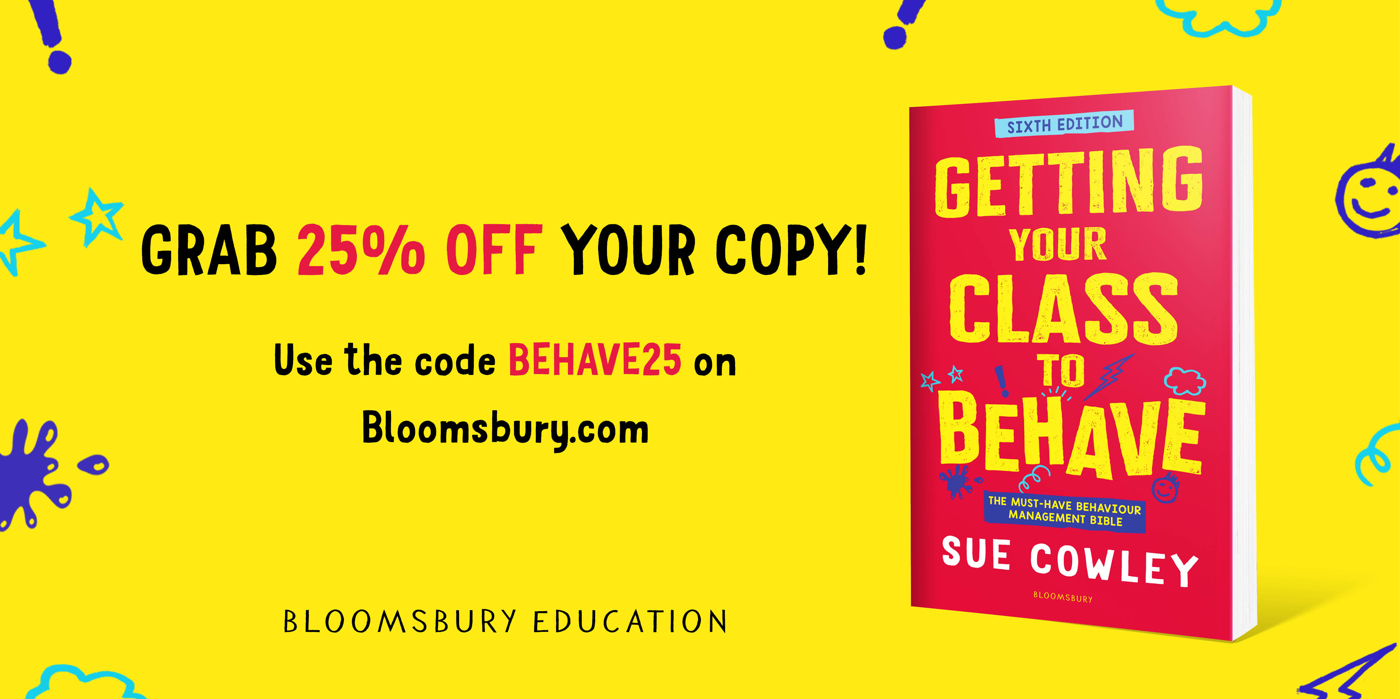
In Conclusion …
Find lots more practical tips in the new edition of my behaviour book, published 30th May!
Preorder on Amazon, or get a copy with a 25% discount via Bloomsbury

